Slide 1

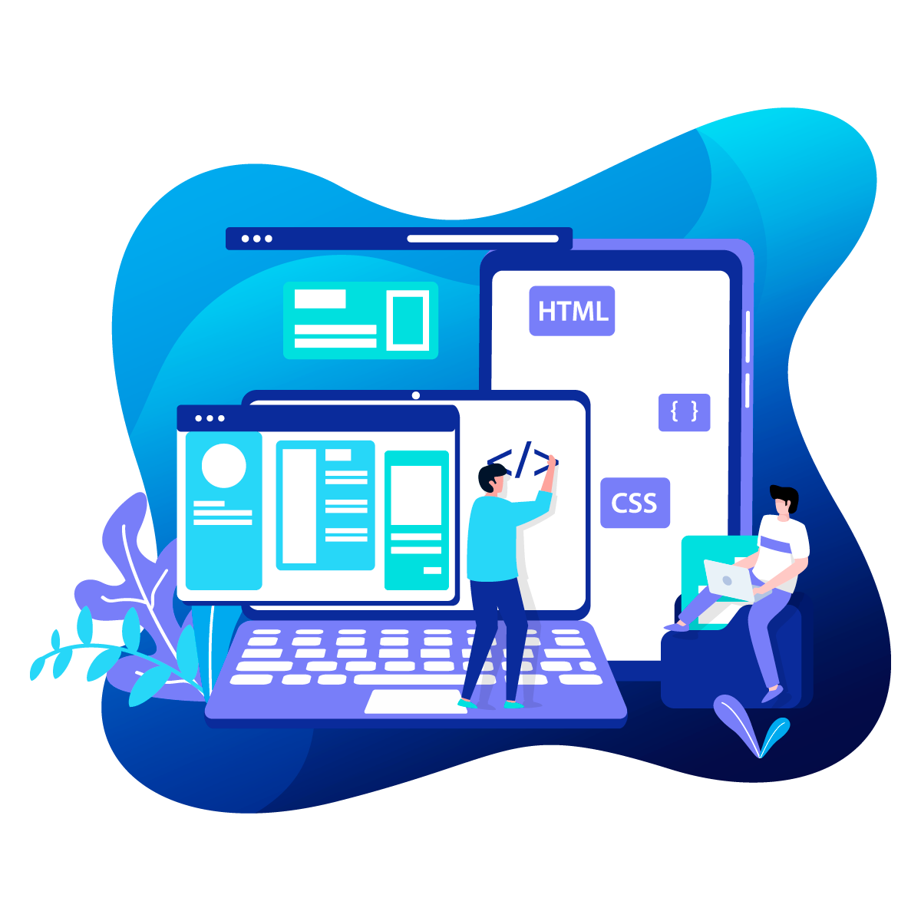
Practical - Exercise
Orientation Programme - Batch 21 Faculty of Information Technology University of Moratuwa
Preliminaries of Web Technologies

Slide 2
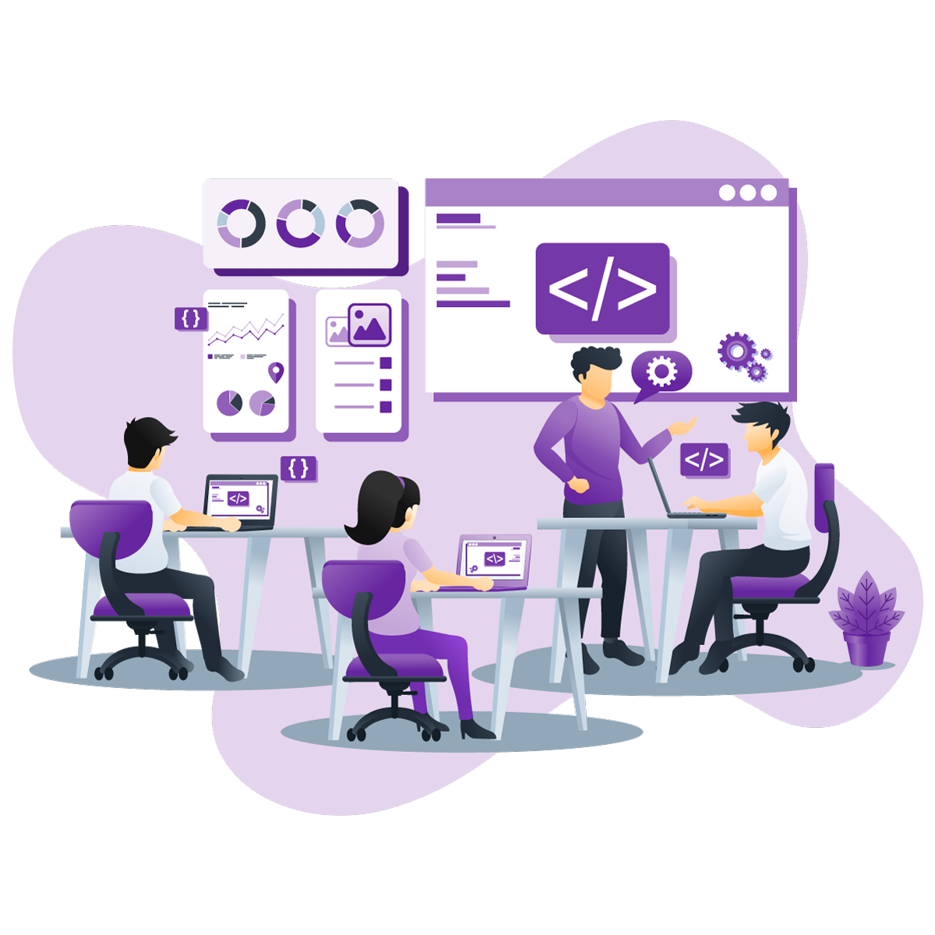
Welcome
Group - 81
We are from

Slide 3


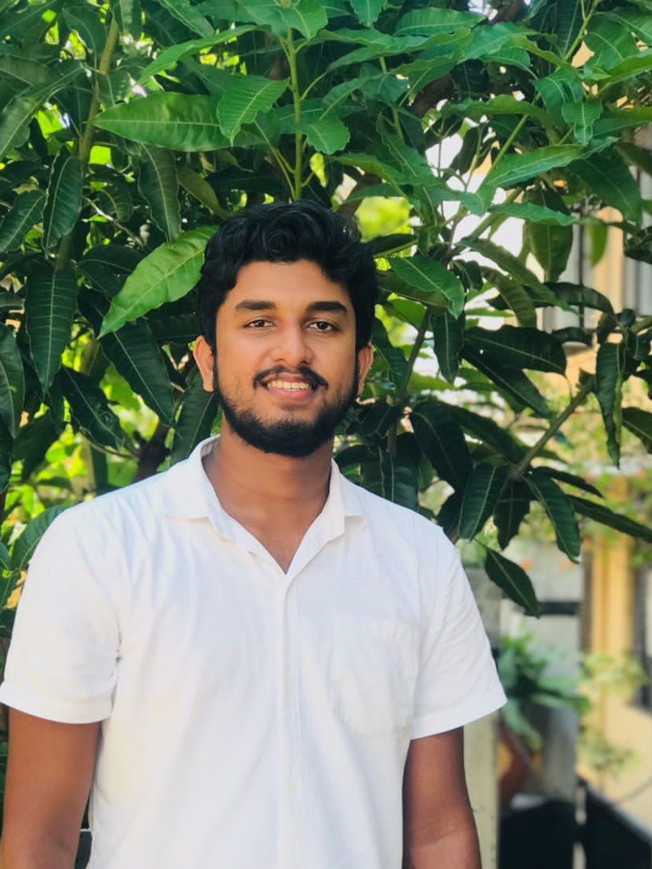
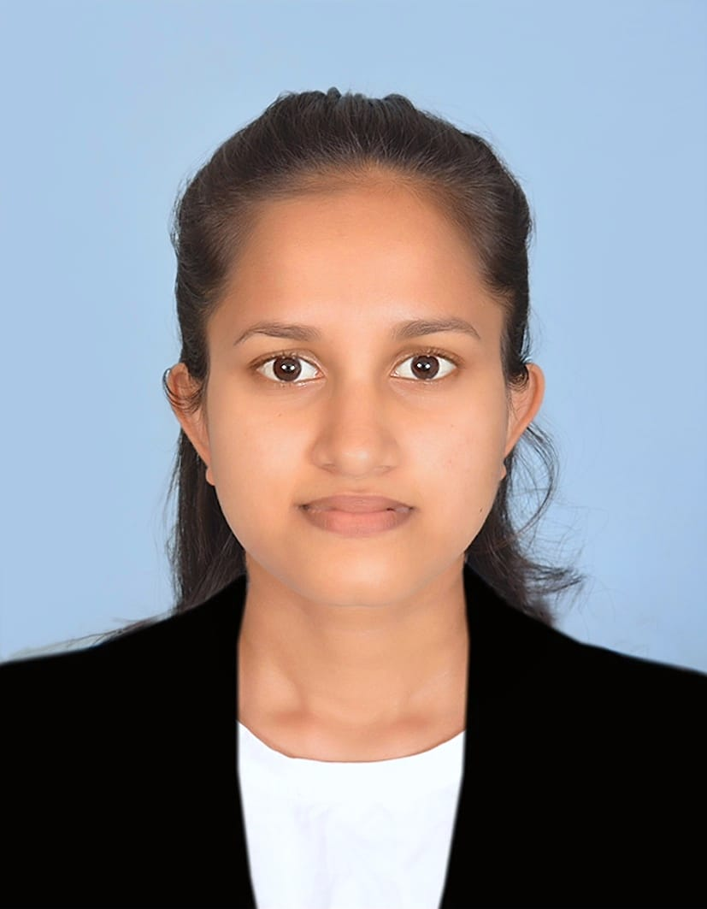
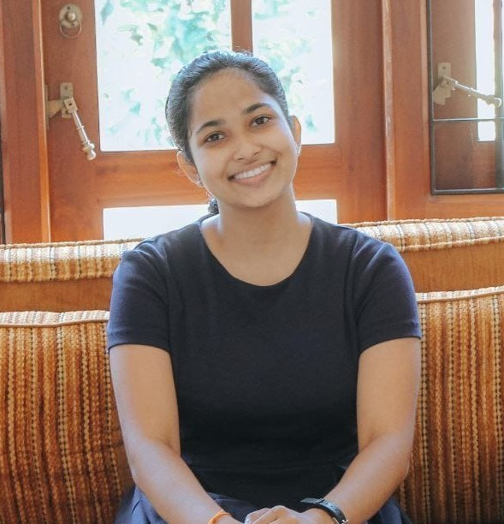
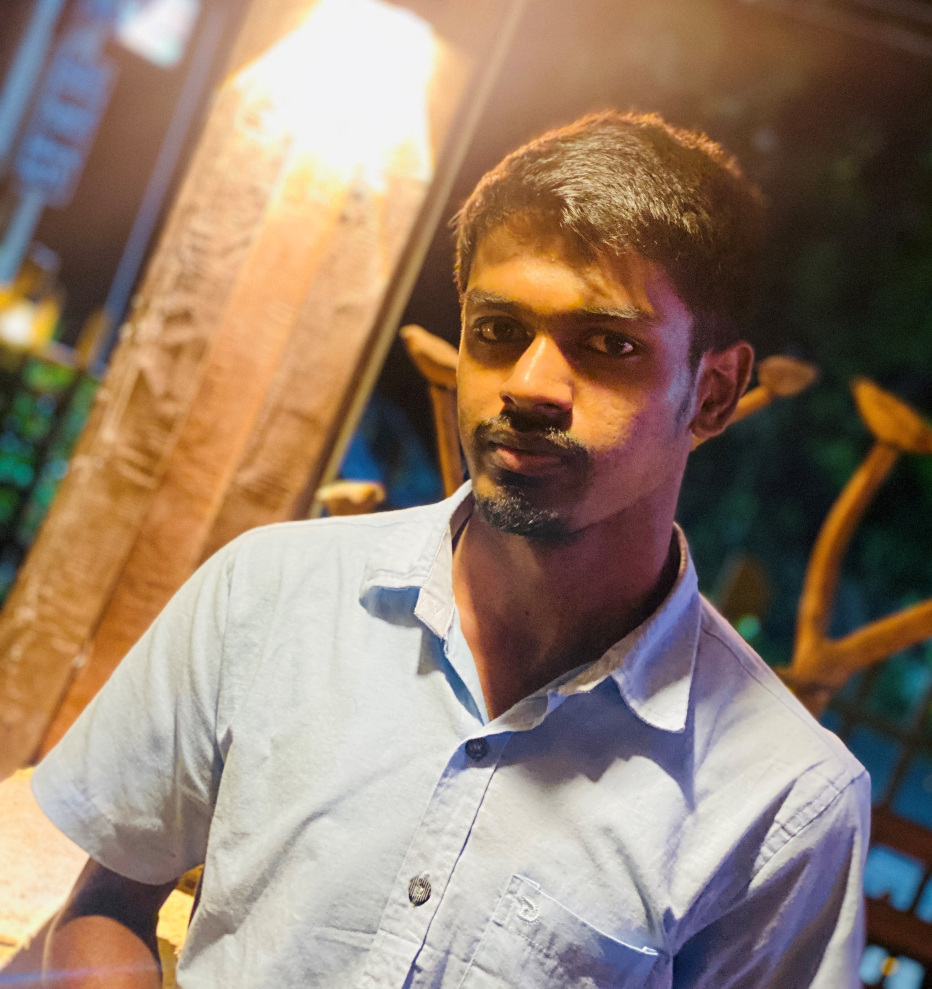
Team Members
Malintha Kavinda
Mihiliya Maheshika
Amasha Shivoni
215062R
215072X
215123G
Kasun Jayasanka
215094
Team Leader

Slide 4
Why We Selected,
In the session of preliminaries of web technologies, we learned HTML, CSS and Javascript as Front-End Web Development languages.
We should use these languages practically in our exercise. therefore we decided to clone a website using these languages which has been chosen from the educational domain.
hence, we have cloned an online course website front-End UI practically as a group and got many experiences when continuing our progress as a group.

Slide 5
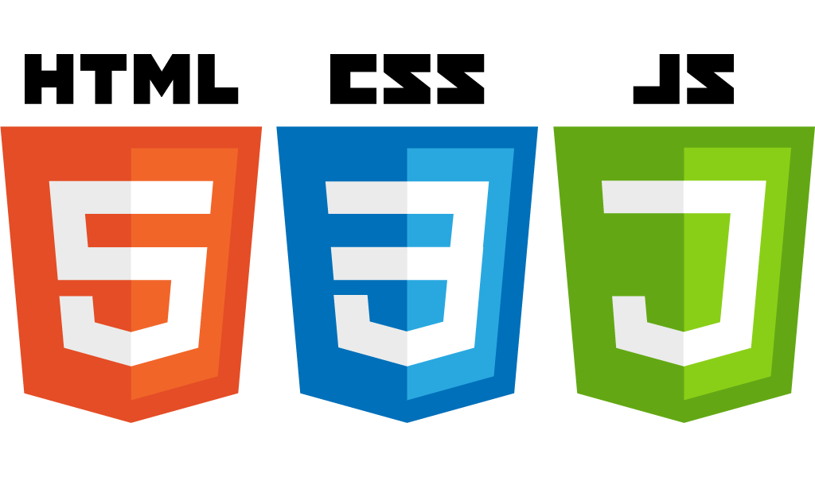

We’ve developed
Using,
SWIPERJS

Slide 6


External Sites that helped to styling & functions
to add Icons
to embed fonts
to get form responses

Slide 7

How We work together remotely
We've been collaborating with each other using,
code hosting platform for version control and collaboration.
Link of the GitHub Repository
https://github.com/KasunJayasanka/PracticalExercise-Front-End.git

Slide 8
Let’s Move on to see How Website Looks Like Quickly

Slide 9
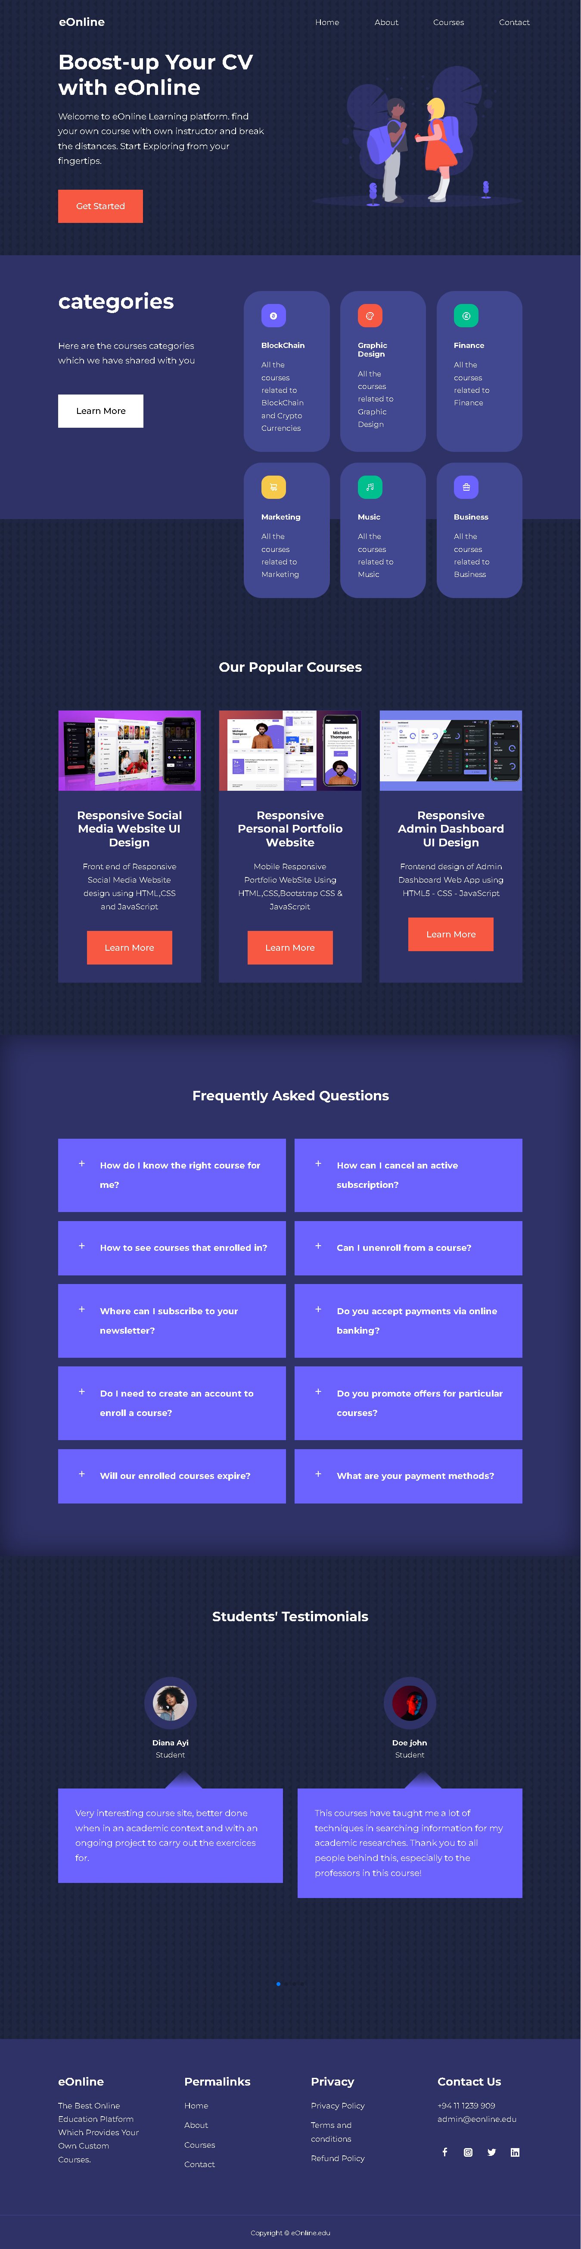
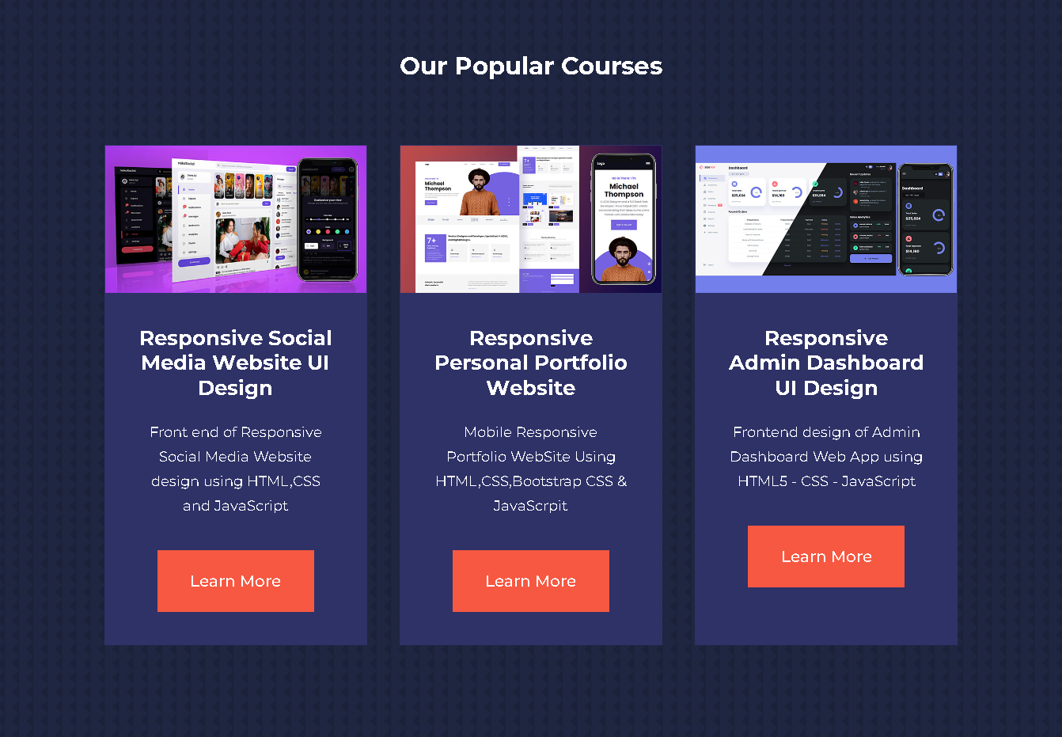
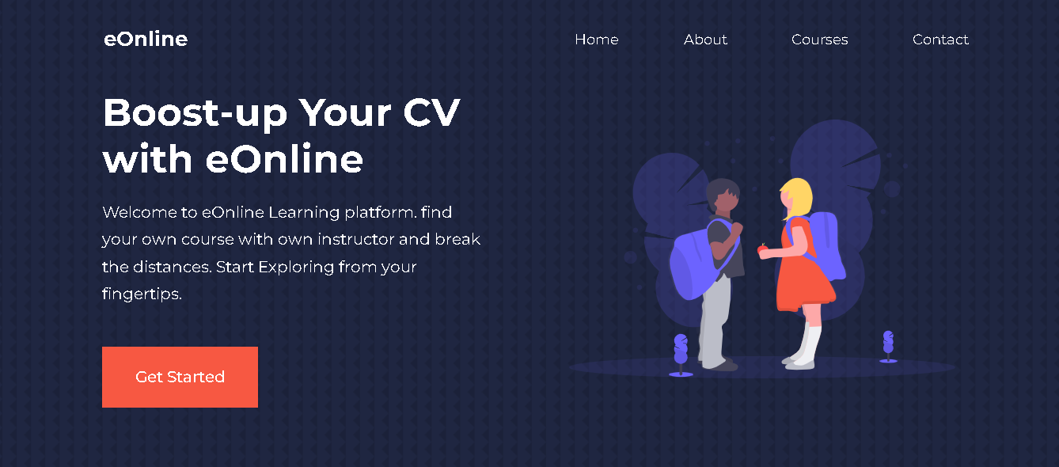
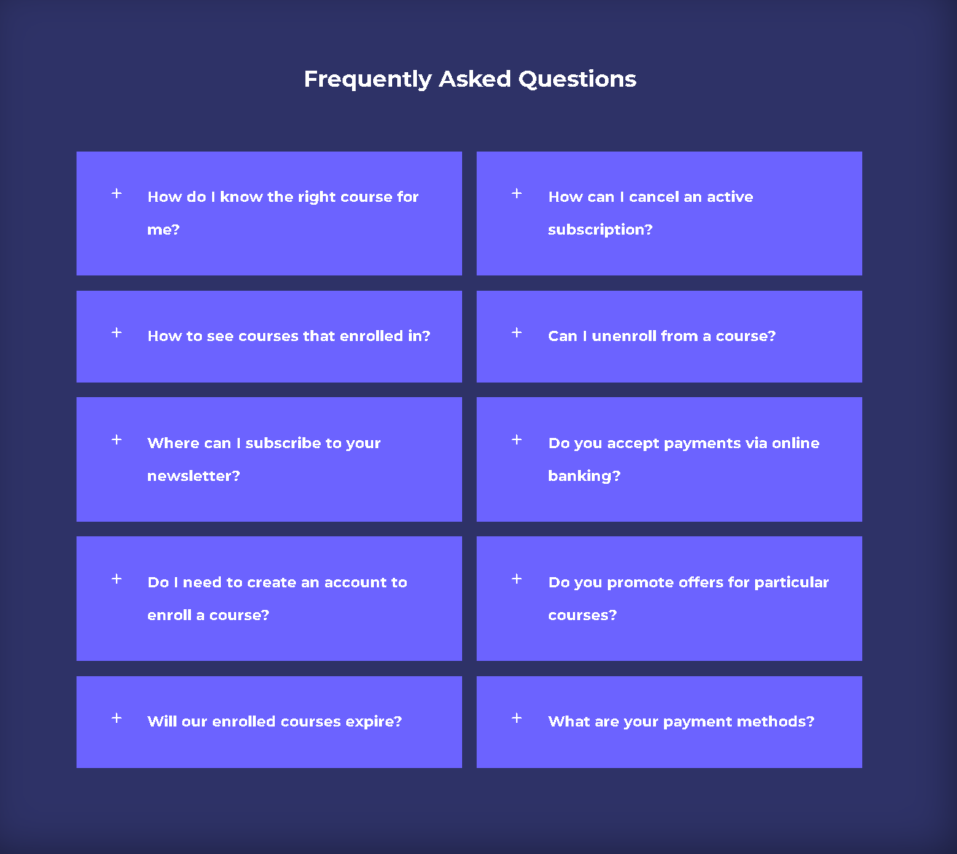
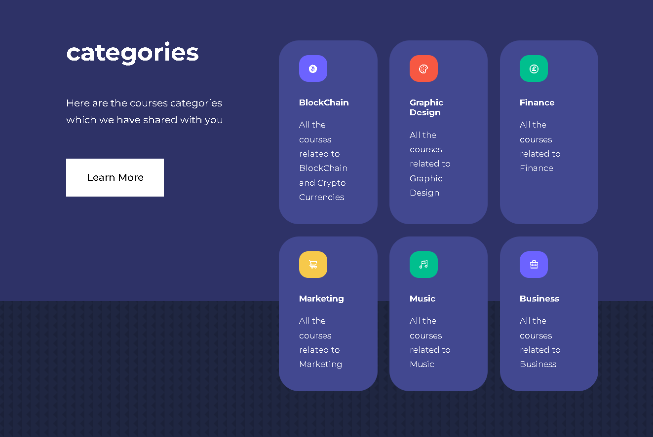
Home Page

Slide 10
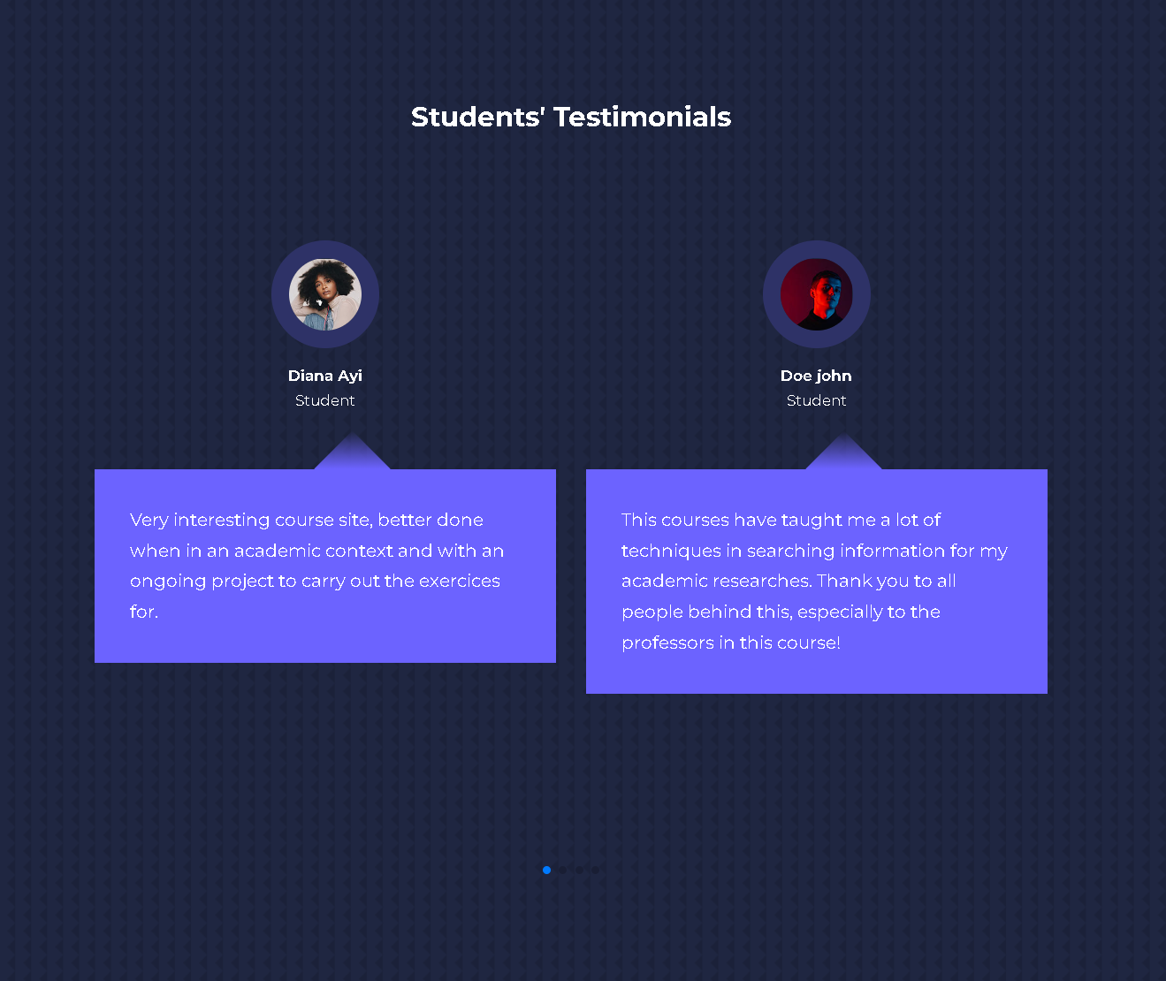
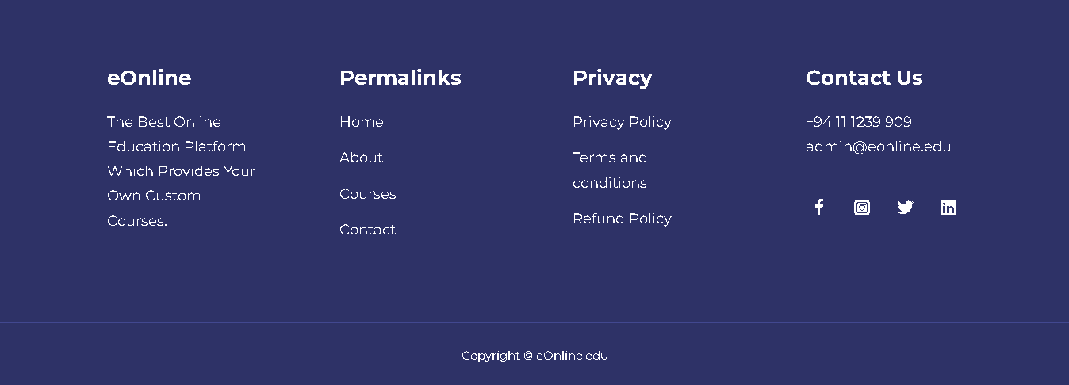
Home Page

Slide 11
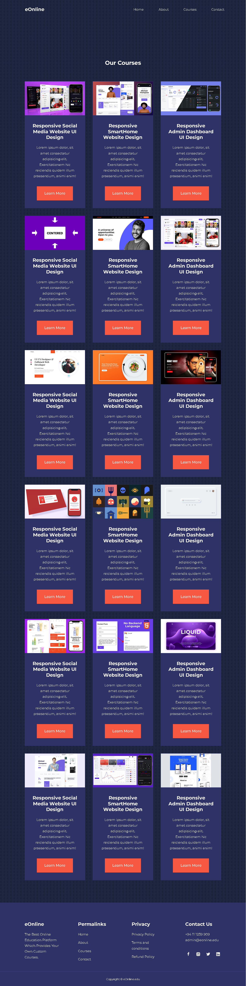
Courses
Page

Slide 12

Finally,
We hosted cloned website using
Pages
https://kasunjayasanka.github.io/PracticalExercise-Front-End/

Slide 13

Q & A

Slide 14

Thank You!

